Slide 1
Lung volumes and capacities
Dr. D T D Warnakulasuriya
Department of Physiology
Faculty of Medicine
University of Kelaniya

Slide 2
Objectives
At the end of this lecture, the student should be able to
describe lung volumes and capacities in a normal individual
describe the change in lung volumes and capacities in patients with restrictive and obstructive lung disease
calculate the following
Total pulmonary ventilation/ Respiratory minute volume
Alveolar ventilation
Dead space volume
understand principles and techniques of investigating lung volumes and capacities

Slide 3
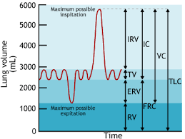
Pulmonary Function Measurements
The total amount of air that the lungs can accommodate is divided into four volumes and four capacities
Lung volumes and capacities are recorded by techniques of spirometry and total body plethysmography
Maximum possible inspiration
Maximum possible Expiration

Slide 4
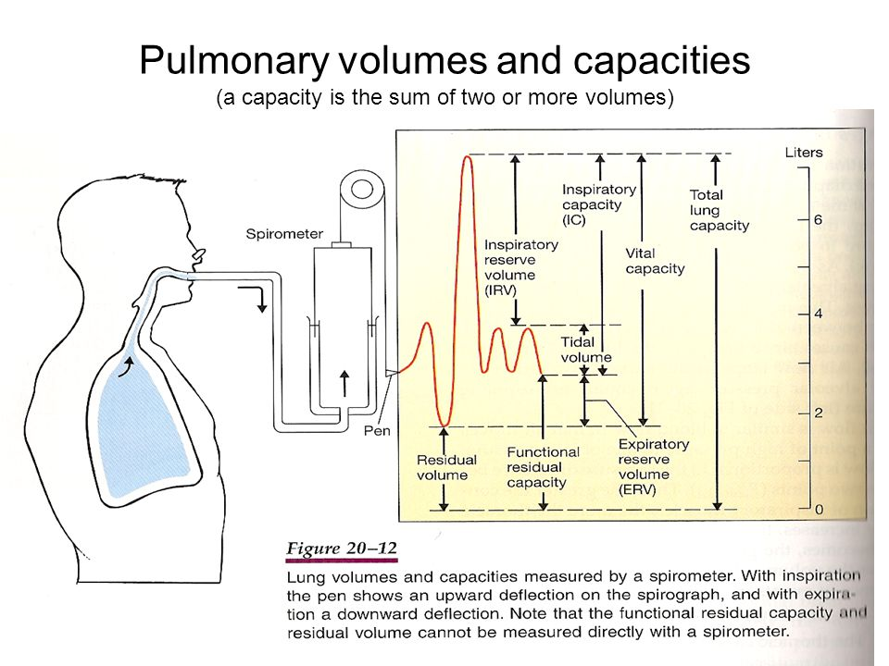

Slide 5
Lung volumes
Maximum possible inspiration
Tidal volume (TV)
Residual volume (RV)
Inspiratory reserve volume (IRV)
Expiratory reserve volume (ERV)
Maximum possible Expiration

Slide 6
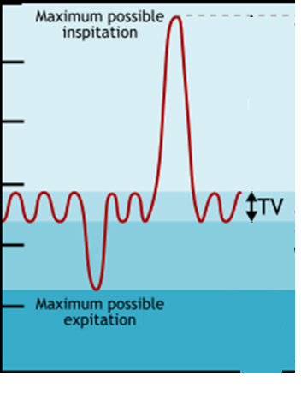
Tidal volume (TV)
The volume of air that normally moves in and out of the lungs in one quiet breath
The amount of air that moves into lungs with each inspiration (or the amount that moves out of lungs with each expiration)
~ 500 mL

Slide 7
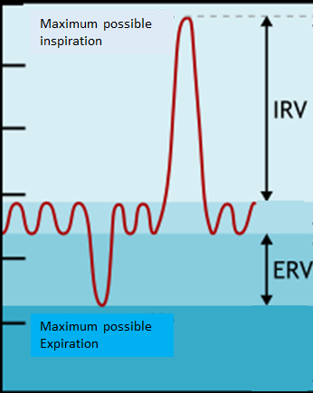
Inspiratory reserve volume (IRV)
the maximum volume of air that can be inhaled after a normal tidal volume inhalation
~2 L
Expiratory reserve volume (ERV)
the maximum volume of air that can be exhaled after a normal tidal volume exhalation
~1L

Slide 8
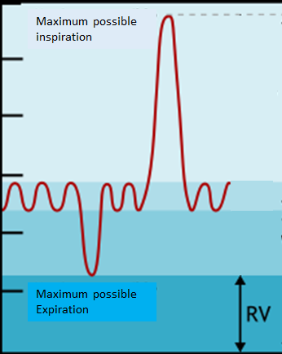
Residual volume (RV)
The amount of air remaining in the lungs after maximum exhalation
~1.3L
Volume of air that cannot be exhaled
Because the residual volume (RV) cannot be exhaled, the RV and the lung capacities that contain the RV are measured indirectly by:
Closed circuit helium dilution method
Open circuit nitrogen washout method
Body plethysmography

Slide 9
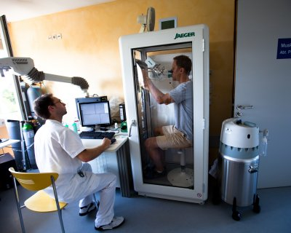
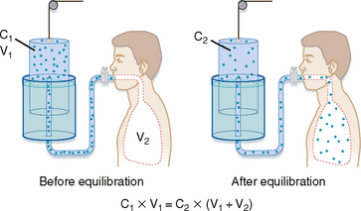
Helium dilution method
Total body plethysmography

Slide 10
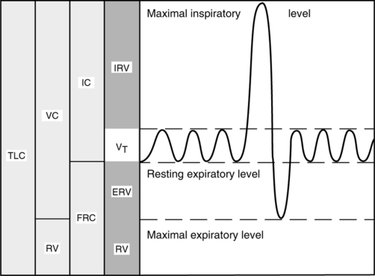
Lung capacities
Total lung capacity (VC+RV)
Total lung volume
~ 5L
Vital capacity (IRV+TV+ERV)
The largest amount of air that can be expired after a maximal inspiratory effort
(FVC- forced vital capacity)
~3.5L
TLC
VC

Slide 11
Inspiratory capacity (TV+IRV)
Amount of air that can be inspired from end expiratory level
~2.5L
Functional residual capacity (FRC=ERV+RV)
Amount of air in the lungs at the end of quiet expiration
~2.5L
IC
FRC

Slide 12
Dead Space
Respiratory (Anatomical) dead space
The volume of air in the conducting zone of the air ways that does not take part in gaseous exchange (excludes alveoli and gas exchanging portions)
2mL/kg (=150mL)
Is expired first during expiration
Measured by nitrogen breath washout test (REFER)

Slide 13
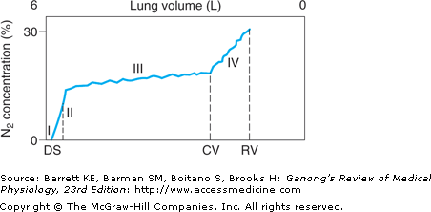
N₂ breath wash out test

Slide 14
Physiological dead space
Anatomical dead space + “functional dead space”
Due to non/ poor ventilation or non/ poor perfusion of alveoli
In a normal person,
Anatomical dead space = physiological dead space

Slide 15
Important calculations
Respiratory minute volume (pulmonary ventilation)
The amount of air inspired per minute
= TV X respiratory rate
Alveolar ventilation
The amount of air that takes part in gas exchange
= (TV-respiratory dead space) X respiratory rate

Slide 16
Maximum voluntary ventilation
The largest volume of air that can be moved in and out of the lungs in 1 minute by voluntary effort
Measured over 15 seconds and then prorated to a minute
140-180 L/min for a healthy adult male

Slide 17
Changes to lung volume and capacities in disease states

Slide 18
In restrictive lung disorders:
Tidal volume (V_{T}), residual volume (RV), Vital capacity (VC), inspiratory capacity (IC), functional residual capacity (FRC), and total lung capacity (TLC) are all decreased
Restrictive lung disorders include pulmonary fibrosis, adult respiratory distress syndrome, and pulmonary oedema

Slide 19
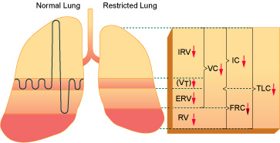

Slide 20
In obstructive lung disorders:
Increase in : Residual volume (RV)
Functional residual capacity (FRC)
Residual volume/total lung capacity (RV/TLC) ratio
Decrease in : Inspiratory reserve volume (IRV)
Expiratory reserve volume (ERV)
Inspiratory capacity (IC)
Vital capacity (VC)
Obstructive lung disorders include asthma and COPDs, such as emphysema and chronic bronchitis

Slide 21
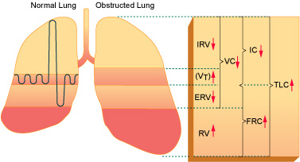

Slide 22
Tests of ventilatory function
Peak expiratory flowmetry
Spirometry
Helium dilution method
Total body plethysmography

Slide 23
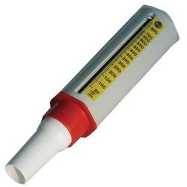
Peak expiratory flow metry
Peak expiratory flow rate
Measures airflow obstruction in large airways
Effective in diagnosis and monitoring of obstructive airways diseases

Slide 24
Technique of Measuring PEFR
Stand straight, take a deep breath, fill your chest and ‘BLAST’ out the air
Select best of 3 blows
Output is the peak expiratory flow rate (PEFR) (maximum speed of expiration)
Compared against nomogram

Slide 25
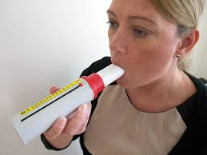
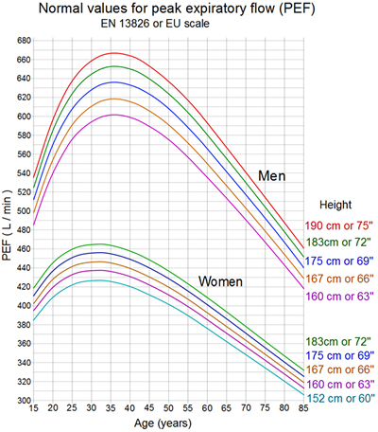
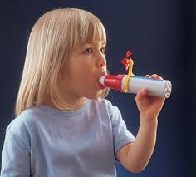
Peak expiratory flow metry

Slide 26
% predicted PEFR
Patient’s value x 100
Expected value
≥ 70% - normal

Slide 27
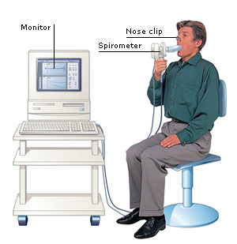
Spirometry
Spirometer measures the air-flow in and out of lungs
Subject takes a deep breath, fixes mouth over mouthpiece and breathes out as fast as and as far as he can
Measurements vary with age,sex and height

Slide 28
Forced expiratory manoeuvre
Technique
Stand/ sit straight
Take a full deep breath and fill your chest
Hold mouthpiece between lips to create a good seal
Blow as fast and hard and long as possible until no breath is left
Output: volume-time curve

Slide 29
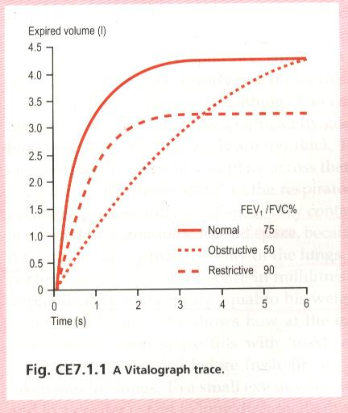
Forced Vital Capacity – FVC
Largest volume expired after a maximal inspiration
A measure of pulmonary function
Forced Expiratory Volume at 1st second - FEV₁
Fraction of vital capacity expired during 1st second of a forced expiration
A good measure of air flow limitation
FVC
FEV₁

Slide 30
FEV₁/FVC ratio
FEV₁ expressed as a percentage of FVC
Is an excellent measure of airflow limitation
In normal individuals
FVC >70%
FEV₁ >70%
FEV₁/FVC >70%

Slide 31
Expiratory & inspiratory manouvre
Technique
Stand/sit straight
Hold mouthpiece between lips to create a good seal
Breath in and out normally about 2-3 times
Take a deep breath
Breath out as fast and hard as possible until no breath is left
Breath in rapidly to maximum capacity
Output: flow-volume loop

Slide 32
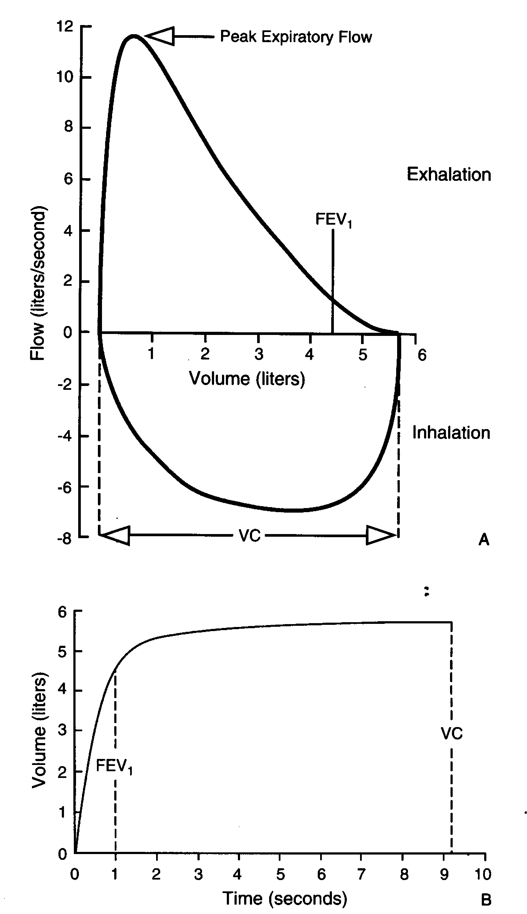
Flow rate versus volume (flow volume loop)
Mid expiratory flow rate
FEF_{25-75%}

Slide 33
Indicates whether
airway obstruction is present
lung capacity is reduced

Slide 34
Obstructive airway disease
Seen in narrowing of airways
e.g. asthma, emphysema, chronic bronchitis
Inspiration not much affected, fills to a normal maximum slowly
Expiration is severely affected,
as resistance of small airways increases,
rate of flow decreases
prolonged expiration
FEV₁/FVC <70%

Slide 35
Restrictive airway disease
Seen in restrictive lung diseases
e.g. Pulmonary fibrosis, respiratory muscle diseases
Both FVC and FEV₁ reduced (<70%)
FEV₁/FVC > 70%

Slide 36
A
C
B

